Slide 1




4
Unit 1 Section A
Love and logic:
The story of a fallacy
FOREIGN LANGUAGE TEACHING AND RESEARCH PRESS
AIR FORCE ENGINEERING UNIVERTISY
Notes:
1

Slide 2
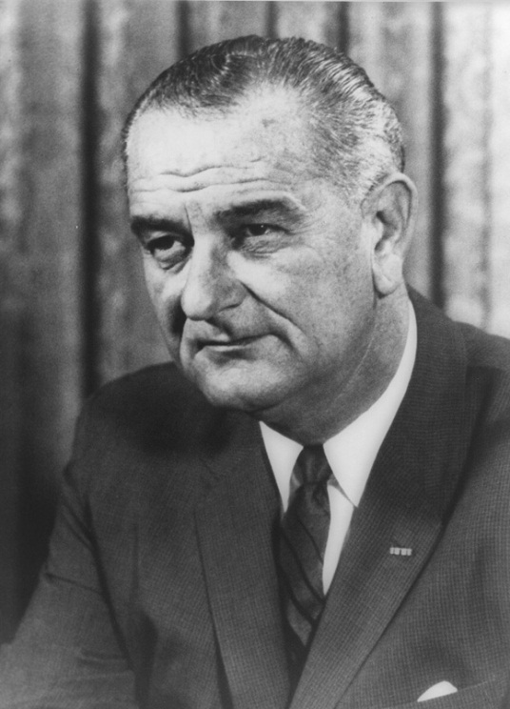
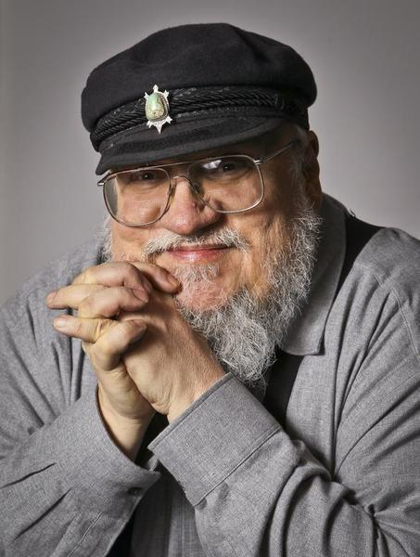
4
1
Life and Logic
UNIT
Doing the right thing is not the problem. Knowing what the right thing is, that’s the
challenge.
— Lyndon B. Johnson (36th US president)
It is one thing to be clever and another to be wise.
— George R. R. Martin (American author)
Notes:
2

Slide 3

^{Section A}
4
1
Life and Logic
UNIT
Love and logic: The story of a fallacy
To talk about love and logic
Objectives
To further understand the text
To apply the phrases and patterns
To master the narrative essay writing skill

Slide 4
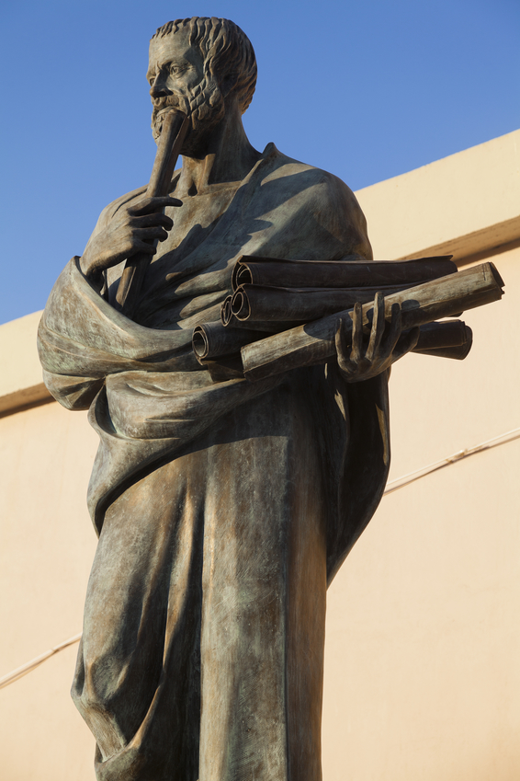




A
Love and logic: The story of a fallacy
Section
Contents
Warming-up Activities
Text Study
Language Application
Summary

Slide 5




A
Love and logic: The story of a fallacy
Section
Warming-up Activities
Lead-in
Pre-reading Activities
Cultural Background

Slide 6


1. What do you know about logic?
It is the use and study of valid reasoning;
Most prominent in the subjects of philosophy, mathematics, and computer science;
Established as a formal discipline by Aristotle;
One of the classical trivium (三学科), the other two being grammar and rhetoric;
Divided into three parts: inductive reasoning, abductive reasoning, and deductive reasoning.

Slide 7
2. Do you think it is possible to deal with life in a completely rational and logical way?
When it comes to making a choice, many people tend to use rational and logical reasoning;
Males are more rational than females;
Rational world is not necessarily a wonderful one;
Rational individuals can make choices that are bad news for others;
It is ridiculous to deal with love in a logical way.

Slide 8
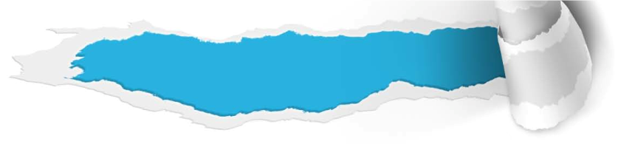

Pre-reading Activities
True or False
The following are some statements to test your reasoning ability. Tell whether the conclusions after the word “Therefore” are true (T), false (F), or uncertain (U). Write your answer on the line before each statement.

Slide 9
Pre-reading Activities
True or False
1. All odd numbers are integers (整数). All even numbers
are integers. Therefore, all odd numbers are even
numbers.
2. There are no dancers that aren’t slim and no singers
that aren’t dancers. Therefore, all singers are slim.
3. A toothpick (牙签) is useful. Useful things are valuable.
Therefore, a toothpick is valuable.
4. Three pencils cost the same as two erasers. Four
erasers cost the same as one ruler. Therefore, pencils
are more expensive than rulers.
5. Class A has a higher enrollment than Class B. Class
C has a lower enrollment than Class B. Therefore,
Class A has a lower enrollment than Class C.
F
T
T
F
F

Slide 10
Pre-reading Activities
True or False
6. A fruit basket contains more apples than lemons.
There are more lemons in the basket than oranges.
Therefore, the basket contains more apples than
oranges.
7. Taking the train across town is quicker than taking
the bus. Taking the bus across town is slower than
driving a car. Therefore, taking the train across town
is quicker than driving a car.
8. All the tulips in Zoe’s garden are white. All the roses
in Zoe’s garden are yellow. Therefore, all the flowers
in Zoe’s garden are either white or yellow.
T
U
U

Slide 11



Listen to a short passage on logic, and fill in the missing information.
Logic is the use and study of valid . The study of logic features most prominently in the subjects of philosophy, , and computer science.
Philosophical
reasoning
mathematics
To be continued

Slide 12

Listen to a short passage on logic, and fill in the missing information.
Logic was studied in several ancient , including India, China, Persia and Greece. In the West, logic was established as a formal by Aristotle, who gave it a fundamental place in philosophy. The study of logic was part of the classical trivium (三学科), which also included and rhetoric.
civilizations
discipline
grammar
To be continued

Slide 13

Listen to a short passage on logic, and fill in the missing information.
Logic was further by Al-Farabi who categorized it into two separate groups (idea and ). Later, Avicenna revived the study of logic and developed relationship between temporalis and the
(时间与意义). In the East, logic was developed by Hindus, Buddhists and Jains (耆那教徒).
extended
proof
implication
To be continued

Slide 14

Listen to a short passage on logic, and
fill in the missing information.
Logic is often divided into three parts: reasoning, abductive reasoning, and deductive reasoning.
inductive

Slide 15

Cultural Background
Logic and Fallacy
Questions Previewing
1. What is a fallacy? And how is it used?
Tips
2. How many types of fallacy do you know?
Tips

Slide 16

Cultural Background
Logic and Fallacy
What is a fallacy? And how is it used?
An error in reasoning that renders an argument logically invalid;
By accident or design, logical fallacies are often used in debate or propaganda;
To mislead people;
To distract people from the real issue for the purpose of winning an argument.

Slide 17

Cultural Background
Logic and Fallacy
2. How many types of fallacy do you know?
Red Herring (转移话题)
Begging the Question
(循环论证)
Slippery Slope (滑坡谬误)
Bandwagon (从众谬误)
False Dilemma
(伪两难谬误)
False Cause (post hoc)
(假因谬误)
Ad Hominem ( 人身攻击)
Appeal to Authority
(诉诸权威)
Dicto Simpliciter (绝对判断)
Hasty Generalization
(草率结论)
Ad Misericordiam
(文不对题)
False Analogy (错误类比)

Slide 18


A
Section
Love and logic: The story of a fallacy
Text Study
Main Idea & Structure
Language Focus
Critical Thinking

Slide 19


What did the narrator do with his roommate Rob? (Para.1)
Tips
They made a deal that the narrator gives Rob his leather jacket, and Rob, in exchange, gives the narrator his girlfriend.
Notes:
19

Slide 20

Why did the narrator want to have Polly as his girl friend? (Paras. 2-3)
Tips
Pretty, well-off, radiant;
The right background to be the girlfriend of a dogged, brilliant lawyer;
Help the narrator in his competition with other applicants to some elite law firms.
Notes:
20

Slide 21

Part I — Paras. 1–__
3
The author sets the scene of the story by providing information about the four “wh-” words: who, where, what, and why. “Who” refers to the narrator, his roommate Rob, and the beautiful girl Polly. “Where” refers to . “What” and “why” refer to what to do and why to do it: The narrator decides to make Polly
“ ” because as a promisingly brilliant lawyer, he wants to have a girlfriend who is not only beautiful but also intelligent.
a college campus
well-spoken

Slide 22
Paras. 4-8
After a day out with Polly, I drove her to a big old oak tree on a hill off the highway, where we could enjoy a perfect view of the . Then I was ready to talk with Polly about logic, the first thing under our discussion is the fallacy .
banner
luminous city
Dicto Simpliciter
Notes:
22

Slide 23
What is Dicto Simpliciter? Give an example.
(Paras. 9-11)
Tips
An unqualified, too simple generalization;
One example: Exercise is good, therefore, everybody should do exercise.
Notes:
23

Slide 24
What is Hasty Generalization? Give an example.
(Paras. 12-15)
Tips
An unqualified, too simple generalization;
One example: Exercise is good, therefore, everybody should do exercise.
Notes:
24

Slide 25
What is Ad Misericordiam? Give an example.
(Paras. 16-21)
Tips
Appealing to one’s sympathy instead of answering the question directly;
One example: A man applies for a job. When the boss asks him what his qualifications are, he says he has six children to feed.
Notes:
25

Slide 26
What is False Analogy? Give an example.
(Paras. 22-25)
Tips
Wrong inference;
Making an analogy between two situations that are altogether different;
One example: Students should be allowed to look at their textbooks during exams, because surgeons have X-rays to guide them during surgery.
Notes:
26

Slide 27
Part II — Paras. 4-25
The narrator tries to help Polly become smarter by giving her lessons in logic. Altogether he spends five nights teaching Polly four logical , namely, Dicto Simpliciter, , Ad Misericordiam, .
fallacies
Hasty Generalization
False Analogy

Slide 28
Paras. 26-32
When the narrator asks Polly to be his girlfriend, Polly refutes his first argument “We make a pretty good couple” as “ ” and his second argument “You don’t have to eat a whole cake to know it’s good” as “ ”.
Hasty Generalization
False Analogy
Notes:
28

Slide 29
Paras. 33-37
When the narrator asks Polly to be his girl friend, Polly refutes his third argument “Please say you’ll go out with me. I’m nothing without you” as “ ” and his fourth argument “You know the things you learn in school don’t have anything to do with real life” as “ ”.
Ad Misericordiam
Dicto Simpliciter
Notes:
29

Slide 30
What happened at last? (Paras. 38-43)
Tips
Polly refused to be the girlfriend of the author;
Full disclosure;
Polly liked Rob in leather;
She told Rob to make the pact with the author so that he could have the jacket.
Notes:
30

Slide 31
Part III — Paras. 26-43
When asked to be the narrator’s girl friend, Polly refutes his arguments with the exact
taught by him and refuses by making that she is dating the narrator simply because it is a trick she and Rob have decided to play on him in order to get his .
logical fallacies
full disclosure
leather jacket

Slide 32

Introduction to the story
The narrator and Rob make a deal: the exchange of a leather jacket for Polly. (Para. 1)
Polly has some basic qualities to be the girlfriend of a lawyer.(Para. 2)
Polly needs to be made more intelligent. (Para. 3)

Slide 33
Introduction
Body (Development of the story)
Why logic is important (Para. 4-8)
The first logical fallacy taught to Polly: Dicto Simpliciter (Paras. 9-11)
The second logical fallacy taught to Polly: Hasty Generalization (Paras. 12-15)
The third logical fallacy taught to Polly: Ad Misericordiam (Paras. 16-21)
The fourth logical fallacy taught to Polly: False Analogy (Paras. 22-25)

Slide 34
Introduction
Body
The climax and end of the story
(Polly’s refutation and the final disclosure)
“We make a pretty good couple.”
Hasty Generaliza-tion. (Paras. 26-30)
“You don’t have to eat a whole cake to know it’s good.”
False Analogy. (Paras. 31-32)
“Please say you’ll go out with me. I’m nothing without you.”
Ad Misericordiam. (Paras. 33-35)
“You know the things you learn in school don’t have anything to do with real life.”
Dicto Simpliciter. (Paras. 36-37)
Climax of the story:
Polly refuses to be the narrator’s girlfriend. (Paras. 38-43)

Slide 35
Introduction
Body
Climax & End

Slide 36

Love and logic: The story of a fallacy
My roommate Rob made a with me that he’d give me his girlfriend Polly in exchange for my jacket. And I agreed.
Polly had the right background to be the girlfriend of a lawyer like myself. She was pretty, well-off, and radiant. Still, I want to dispense her enough to make her “well-spoken”.
pact
dogged, brilliant
pearls of wisdom
To be continued

Slide 37
So I tried my best to teach her such logical as Dicto Simpliciter, Hasty Generalization, Ad Misericordiam, and False Analogy. After five nights of diligent work, I actually made a out of Polly. She was an at last.
fallacies
logician
analytical thinker
To be continued

Slide 38
When I asked her to develop our relationship into a one, however, she my arguments as those logical fallacies I had taught her! And she refused my proposition by making full : She liked Rob in leather, therefore, she had told him to make the pact with me so that Rob could have my .
romantic
refuted
disclosure
jacket

Slide 39

Practical Phrases | Specific Meanings
1. In exchange for… | 作为对……的交换
2. Set a date for | 为……定日期
3. Appeal to | 唤起；吸引
4. make/draw an analogy between | 在……之间作类比
5. Make sth. out of sb./sth. | 使……变成……
6. Give sb. the axe | 抛弃（恋人）；解雇
7. Be dripping with … | 满是……

Slide 40

作为对……的交换
短语逆译
in exchange for…
短语应用
为了给后代换来一个和平的环境，我们的革命先烈们抛头颅、洒热血。
意群提示
(revolutionary predecessors/shed blood/sacrifice one’s life)
In exchange for a peaceful environment for the future generations, our revolutionary predecessors shed their blood and even sacrificed their precious lives.

Slide 41
为……定日期
set a date for
短语逆译
短语应用
要想取得成功，最好马上开始努力，不要推三推四。
意群提示
(to achieve success/rather than)
In order to achieve success, one had better start immediately rather than set dates for his/her efforts.

Slide 42
唤起；吸引
短语逆译
appeal to
短语应用
这所大学拥有许多世界知名的专家、教授以及世界上最好的研究图书馆，因此吸引了来自世界各地的学子和研究人员。
意群提示
(boast/research library)
This university boasts many world-famous experts, professors, and the world’s best research library, therefore, it appeals to students and researchers from all over the world.

Slide 43
make/draw an analogy between
在……之间作类比
短语逆译
短语应用
我们经常把学习和登山进行类比：两者在你达到巅峰之前都需要付出巨大的努力。
意群提示
(require great efforts/reach the top)
We often make an analogy between studying and climbing a mountain: both of them require great efforts before you can reach the top.

Slide 44
使……变成……
短语逆译
make sth. out of sb./sth.
短语应用
这所军校的目标是经过四年的学习与训练将这些年轻的军校生变成合格的军官。
意群提示
(military academy/young cadets)
The aim of the military academy is to make qualified officers out of the young cadets after four years’ study and training.

Slide 45
抛弃（恋人）；解雇
短语逆译
give sb. the axe
短语应用
如果你继续浪费宝贵的大学时光，毕业时你将一事无成。
意群提示
(play away/upon graduation)
If you continue playing your precious college years away, success will give you the axe upon graduation.

Slide 46
满是……
短语逆译
be dripping with …
短语应用
这位漂亮的女士尽管浑身珠光宝气，言行却低俗无礼。
意群提示
(words and actions/vulgarity and rudeness)
Though the beautiful lady is dripping with jewels, her words and actions are dripping with vulgarity and rudeness.

Slide 47

Functional Patterns | Functions & Usages
1. If sb. could do …, sb. just might do … | 用于表达“假设”
2. Sb. never/seldom do .... Instead, sb. do … | 用于表达“强调”
3. Look at …, look at …. Can you do …? | 用于表达“对比”
Notes:
47

Slide 48
原句译文
如果我能够让我所申请的顶尖律师事务所看到我身边伴随着一位光彩照人、谈吐优雅的另一半，我就很有可能在竞聘中以微弱优势获胜。
逆译练习
If I could show the elite law firms I applied to that I had a radiant, well-spoken counterpart by my side, I just might edge past the competition.
句型提炼
Notes:
48

Slide 49

句型提炼
If sb. could do …, sb. just might do …
应用提示
用于表达 “假设”。
句型应用
Notes:
49

Slide 50
典型例句
如果你能好好利用现有的一切而不是幻想你所没有的，你很可能已经取得巨大的成功了。
意群提示
( make the best of/dream of)
If you could make the best of what you have instead of dreaming of what you don’t have, you just might have already achieved great success.

Slide 51
原句译文
这个人根本没有回答老板的问题，而只是在博取老板的同情。
逆译练习
The man never answered the boss’s question. Instead he appealed to the boss’s sympathy.
句型提炼
Notes:
51

Slide 52
句型提炼
Sb. never/seldom do .... Instead, sb. do …
应用提示
用于表达“强调”。
句型应用
Notes:
52

Slide 53
典型例句
一些人民公仆从不为人民服务，而只是利用手中的特权、职权最大程度地为自己谋取私利。
意群提示
(public servant/ take advantage of/privileges and authorities)
Some of our public servants never serve the people, instead they take advantage of their privileges and authorities to seek personal interests to the maximum extent.

Slide 54
原句译文
看看我，一个聪明过人的学生，一个不同凡响的学者，一个前途无量的人。再看看罗伯，一个肌肉发达的蠢材，一个有了上顿没下顿的家伙。你是否能给我一个充足的理由，为什么要选择跟他？”
逆译练习
Look at me, an ingenious student, a tremendous intellectual, a man with an assured future. Look at Rob, a muscular idiot, a guy who’ll never know where his next meal is coming from. Can you give me one good reason why you should be with him?”
句型提炼
Notes:
54

Slide 55
句型提炼
Look at …, look at …. Can you do …?
应用提示
用于表达“对比”。
句型应用
Notes:
55

Slide 56
典型例句
看看我们，住着高楼大厦，穿着耐克、阿迪，吃着麦当劳、肯德基，喝着百事和可乐。再看看那些战乱地区的难民们，躲在破烂不堪的草棚里，没穿、没吃、没喝。我们怎么还能抱怨我们的生活呢？
意群提示
(tall buildings/war stricken areas/poor straw sheds)
Look at us, living in tall buildings, wearing Nike and Adidas, eating McDonalds and KFCs, drinking Pepsis and Colas. Look at the refugees in the war stricken areas, sheltering in poor straw sheds, having almost nothing to wear, to eat and to drink. How can we complain about our lives?

Slide 57



她已经是“光彩照人”了。但我能够施予她足够多的“智慧之珠”，让她变得“谈吐优雅”。
a. “Radiant” she was already. I could dispense her enough pearls of wisdom to make her “well-spoken”. (Para.3, L1)

Slide 58
我们可以成为很好的一对儿。
b. We make a pretty good couple. (Para.29, L1)

Slide 59
毕竟你不需要吃掉整个蛋糕才知道它好不好。
c. After all, you don’t have to eat a whole cake to know it’s good. (Para.4, L6)

Slide 60
再错几步我可就无法挽回
了。
d. A few more false steps would be my doom. (Para.33, L2)

Slide 61
我一下跳了起来，怒火中烧。
e. I leaped to my feet, my temper flaring up. (Para.38, L1)

Slide 62
看看我，一个聪明过人的学生，一个不同凡响的学者，一个前途无量的人。
f. Look at me, an ingenious student, a tremendous intellectual, a man with an assured future. (Para.42, L1-2)

Slide 63
再看看罗伯，一个肌
肉发达的蠢材，一个有了上顿没下顿的家伙。
g. Look at Rob, a muscular idiot, a guy who’ll never know where his next meal is coming from. (Para.42, L2-3)

Slide 64


1. What logical fallacy is included in the story itself? Why do you think so?
Tips
2. What does the story tell us about love? And what does it tell us about smart people?
Tips
3. Can you think of a logical fallacy you
have committed? Why is it a fallacy and what caused it?
Tips

Slide 65

What logical fallacy is included in the story itself?
Why do you think so?
The story itself includes the fallacy “Dicto Simpliciter”. The narrator assumes that all girls would be happy to date a boy whose future is somewhat guaranteed. Therefore, Polly, a beautiful and wealthy young girl, would certainly fall in love with him – “an ingenious student” and “a man with an assured future”, rather than Rob – “a muscular idiot”. However, to the narrator’s surprise and disappointment, Polly chooses Rob in the end because Rob is fashionable and cool.

Slide 66
2. What does the story tell us about love? And what
does it tell us about smart people?
• Love is blind. It is ridiculous to use logic to deal
with love;
• Smart people sometimes can make wrong
judgments;
• Smart people are sometimes too arrogant and
overconfident;
• Smart people may fall victims to their own
smartness.

Slide 67
3. Can you think of a logical fallacy you have
committed? Why is it a fallacy and what caused it?
Yes, certainly. Actually, logical fallacies are very common in our everyday life. I myself commit logical fallacies very often, too. For example, when I first met my roommate in college, I felt very surprised when he told me he didn’t like noodles. I asked, “People in the north of China like eating noodles. You are from the north, why don’t you like noodles?” Here I committed the logical fallacy “Dicto Simpliciter”. I falsely asserted that all people in the north should like noodles, and there should be no exception to this premise.

Slide 68

What do you know about the difference between Chinese and western patterns of thinking?
Western pattern of thinking tends to be more logical than the Chinese one;
Chinese integral pattern of thinking: man and nature are regarded as an integral whole;
Nature-man Oneness, the unity of Heaven and Earth, Nature and Man, Male and Female, Yin and Yang;
Instead of using logical argumentation of conception-judgment-reasoning, Chinese are used to forming a picture in the mind by imagination and use of intuitive experiences;
Western analytical pattern of thinking: man and nature are separate;
Man against nature, separation between subjective world and objective world;
Viewing the objective world with objective and sober scientific attitudes;
Exploring nature by means of logic and reason;
Grasping the nature of a thing through its phenomena;
Use of logical concepts.

Slide 69



Watch a video clip and discuss some question.
Q: What truly is logic in our life?
Tips
Video Watching

Slide 70


Back

Slide 71

What truly is logic in our life?
Logic is the use and study of valid reasoning. It is important to the development of human civilization, especially in the field of philosophy, mathematics, and sciences. Thanks to Aristotle, the study of logic became one part of the classical trivium, which also included grammar and rhetoric. And ever since then, it has been a useful tool for human beings to quest the world.
to be continued

Slide 72
What truly is logic in our life?
It’s true that we are living in a reasonable world of logic. But does that mean everything we see and experience follows certain logic? Definitely not. As the old saying goes: love is blind. In the text, the narrator tries to win Rob’s girl friend, Polly, over by logically thinking that all girls would be willing to date a boy who’s ingenious, intellectual, and with an assured future, but he failed miserably. It is not a wise thing to use logic to deal with love.
to be continued

Slide 73
What truly is logic in our life?
But on the other hand, love itself is logic. As can be learned in the video clip, after a lifetime of pursuit for the equations and logics that lead to reason, the Nobel prize winner finally asked himself, “What truly is logic? Who decides reason?” And he believes that he has made the most important discovery of his career as well as his life: It is only in the mysterious equations of love that any logical reasons can be found. So to live the true meaning out of our lives in this reasonably logical world, we need to love and be loved.

Slide 74

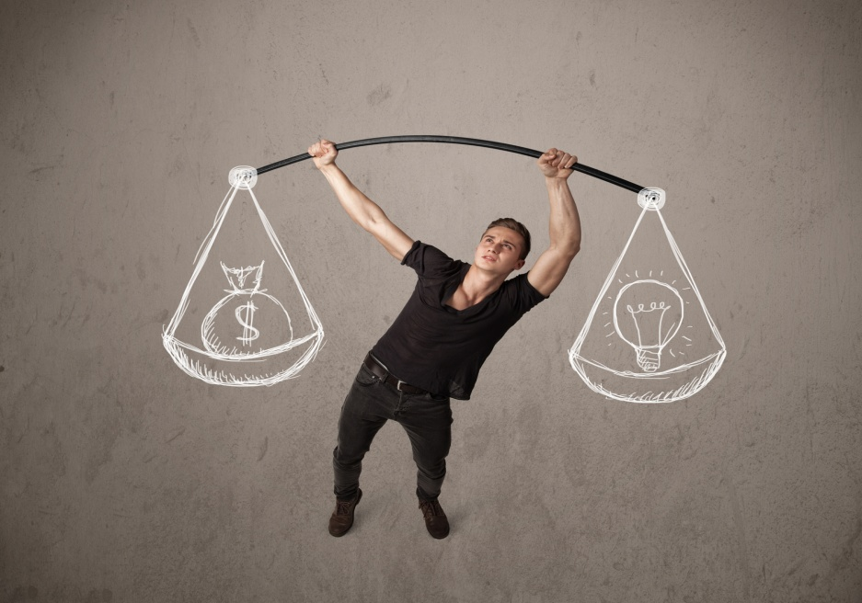
A
Love and logic: The story of a fallacy
Section
Language Application
Writing Devices
Oral Reproduction
Paragraph Translation

Slide 75

Write a narrative essay
Narrative writing can be broadly defined as story writing. It is a piece of writing characterized by a main character who encounters a problem or engages in an interesting, significant or entertaining activity/experience in a particular setting. What happens to this main character is called the “plot”. The plot follows a “beginning, middle, end” sequence. The middle of the story is the largest and most significant part, which we call “the main event”. The main event is what the story is all about and involves either a problem to be solved or a significant life experience for the main character.
to be continued

Slide 76
Structure of a Narrative Essay
1. Introduction: a beginning which introduces the setting and characters of the story, that is, the
time, place and people involved in the story.
2. Body: an account and description of the main event that occurred. This part involves the problem /struggle sequence, or the adventure or interesting peak experience.
3. Conclusion: the part that brings the main event to a close, that is, the problem is solved or the adventure comes to an end.

Slide 77

Take a look at Text A to see how a narrative essay is structured.

Slide 78
Introduction: The author begins by making clear the setting and characters of the story through telling about a deal reached between the narrator and his roommate, Rob – the exchange of a leather jacket for a beautiful girl Polly. (Paras. 1-3)
Body: Then the author continues by writing about the logic lessons the narrator gave to Polly, with vivid descriptions of many details such as his actions and feelings, as well as the girl’s responses to his teaching.
(Paras. 4-25)
Conclusion: Lastly, the author tells how Polly rejected the narrator’s arguments as logical fallacies by using what he had taught her. The climax of the story is reached when Polly refused to be the girlfriend of the narrator. With this humorous but ironic story, the author tries to illustrate the implied central theme: It is ridiculous to deal with love in a logical way. (Paras. 26-43)

Slide 79
Read the sample essay and see how the examples are developed and organized.

Slide 80
Topic: My first meeting with my roommate
Introduction: Introduce the setting and characters of the story (the time, place and people involved).
Body: Give a clear account of what happened (the main event) and include some vivid descriptions of details such as feelings, images, actions, thoughts, facial expressions, etc.
Conclusion: Give a final thought to the story.
to be continued

Slide 81
Sample:
It was my first day at the university. After
finishing all the registration procedures, I got
into the building where I was assigned to live
and searched one door after another for my room number. Finally, I got it. Inside the room, there was already a boy busy making his bed.
(introduction)
After briefly greeting me with “Hi, nice to meet you!” he seemed to have no word any more but continued his bed work quietly, paying no attention to me. “What a stuck-up fellow!”
to be continued

Slide 82
Sample:
I said to myself, feeling a little awkward. Sensing his lack of passion to talk to me, I began to examine our room. It was a small wood-floored dorm in rectangular shape, filled with two sets of bunk beds, tables and chairs, all of which had been thoroughly cleaned. “Was it done by my roommate, the guy with few words?” I asked myself. While getting my bag unpacked, I tried not to lose any chance to stare at him. He was short, thin and dark. His T-shirt was out of fashion and the color had faded; his trousers
to be continued

Slide 83
Sample:
were too loose like an old over-used mop; his sneakers were dirty and nearly ran broken. From the messy hair on his head and the tired look on his face, I could tell he had traveled a long way to come without having enough sleep. “Where is he from? Will he be too different from me?” I wondered. Meanwhile, I began to worry whether he would be easy to get along with.
“Has your luggage arrived? Shall I help you to get it from the post office?” he suddenly asked me in a low voice after he finished making his bed.
to be continued

Slide 84
Sample:
I was a little surprised, but soon recovered and accepted his kind offer since I really needed help. He smiled and then asked me to follow him to the post office. We soon did the work that I would have to use an hour to finish by myself.
(body)
“What a good guy!” I told myself. “We will be friends, and there shouldn’t be anything to worry about.” Though he might be a bit quiet and shy, his generous help to me when we first met had made me believe that he would be a great roommate.
(conclusion)
to be continued

Slide 85
Writing practice
Directions: Write an essay of no less than 200 words on one of the following topics. One topic has an outline you can follow.

Slide 86
Topic: My most embarrassing experience
Introduction: Introduce the setting and characters of the story (the
time, place and people involved).
Body:
Write about the incident that makes you feel so embarrassed. Include vivid descriptions of such details as feelings, images, actions, thoughts, facial expressions, etc.
Conclusion: Conclude the essay with a final thought, a thought provoking question, or a change that you have made after the incident.

Slide 87
More topics:
• A time I felt most proud of myself
• An unforgettable bicycle tour

Slide 88
Oral Reproduction
Story Retelling
Retell the story by using the text’s
structure and expressions.
Suppose you are to tell the text’s story to your audience using the third person.

Slide 89

Oral Reproduction
Story Retelling
You can follow the outline given below.
Part I. Introduction
The narrator and Rob make a deal: the exchange of a leather jacket for Polly.
Why does the narrator want to have Polly as his girlfriend?
Polly needs to be made more intelligent.
To be continued

Slide 90
Oral Reproduction
Story Retelling
You can follow the outline given below.
Part II. Body (Development of the Story)
1. The narrator begins to teach Polly logic in order to
make her intelligent.
2. The first logical fallacy taught to Polly: Dicto Simpliciter.
3. The second logical fallacy taught to Polly: Hasty
Generalization.
4. The third logical fallacy taught to Polly: Ad Misericordianm.
5. The fourth logical fallacy taught to Polly: False Analogy.
To be continued

Slide 91
Oral Reproduction
Story Retelling
You can follow the outline given below.
Part III. Conclusion (Climax and End of the Story)
Polly refutes the narrator’s first argument as Hasty Generalization.
Polly refutes the narrator’s second argument as False Analogy.
Polly refutes the narrator’s third argument as Dicto Smipliciter.
Polly makes the final disclosure and refuses to be the narrator’s girlfriend.
To be continued

Slide 92
Oral Reproduction
Story Retelling
You may adopt the following expressions.
make a pact
in exchange for
a pretty, well-off, radiant, and well-spoken girl
a dogged, brilliant lawyer
pearls of wisdom
set a date for
appeal to one’s sympathy
keep back one’s tears
make an analogy between …
make a logician out of sb.
leap to one’s feet
flare up
give sb. the ax
be dripping with …

Slide 93

Translate a paragraph based on a summary of the text by using the expressions from the text.

Slide 94
波莉拥有合适的家庭背景，足以胜任一名像我一样坚忍而睿智的律师的女友。她漂亮、富有、光彩照人。但是，我想赋予她足够的智慧之珠，从而使得她谈吐优雅。
the right background
a dogged, brilliant lawyer
Pretty, well-off, and radiant
dispense sb. enough pearls of wisdom
To be continued

Slide 95
因此我尽最大的努力教会她诸 如绝对判断、草率结论、文不对题、错误类比的逻辑谬误。在经过五个夜晚的辛勤工作后，我竟然真的将波莉打造成了一个逻辑学行家，她终于能够进行分析思考了。
Dicto Simpliciter
Hasty Generalization
logical fallacies
make sth. out of sb.
be an analytical thinker
To be continued

Slide 96
Polly had the right background to be the girlfriend of a dogged, brilliant lawyer like myself. She was pretty, well-off, and radiant. Still, I want to dispense her enough pearls of wisdom to make her “well-spoken”. So I tried my best to teach her such logical fallacies as Dicto Simpliciter, Hasty Generalization, Ad Misericordiam, and False Analogy. After five nights of diligent work, I actually made a logician out of Polly. She was an analytical thinker at last.

Slide 97



A
Love and logic: The story of a fallacy
Section
Summary
Revision of
the Useful Expressions
Thematic study
Revision of
the Functional Patterns

Slide 98

1 作为对……的交换
2 为……定日期
3 唤起；吸引
4 在……之间作类比
5 使……变成……
6 抛弃（恋人）；解雇
7 满是……
8 签订协定
9 化妆
10 坚韧而睿智的律师
in exchange for …
set a date for…
appeal to
make an analogy between …
make sth. out of sb./sth.
give sb. the axe
be dripping with
make a pact
wear makeup
a dogged, brilliant lawyer

Slide 99
11 施予某人智慧之珠
12 使心情放轻松
13 刹车踏板
14 扭曲事实
15 忍住泪水
16 超越某人的期望
17 一下跳了起来
18 怒火中烧
19 不同凡响的学者
20 四肢发达的蠢材
dispense sb. pearls of wisdom
lighten the mood
brake pedal
distort the truth
keep back one’s tears
surpass one’s expectations
leap to one’s feet
(temper) flare up
a tremendous intellectual
a muscular idiot

Slide 100

Revision of
the Functional Patterns
Functions & Usages | Sentence Patterns
1. 用于表达“假设”
2. 用于表达“强调”
3. 用于表达“对比”
If sb. could do …, sb. just might
do …
Sb. never/seldom do .... Instead,
sb. do …
Look at …, look at …. Can you do …?
Notes:
上面挤，下面空

Slide 101


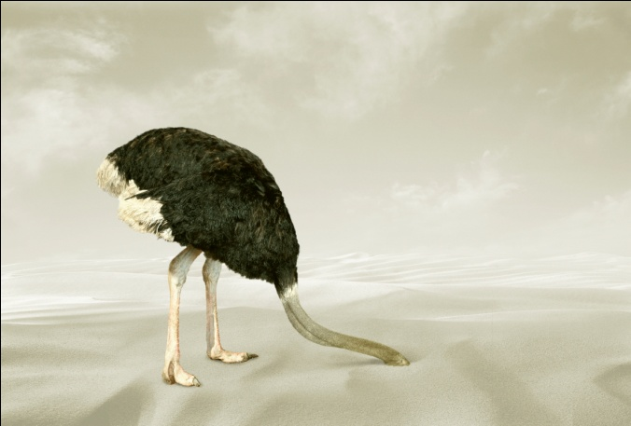
A
Love and logic: The story of a fallacy
Section
The end

